Slide 1
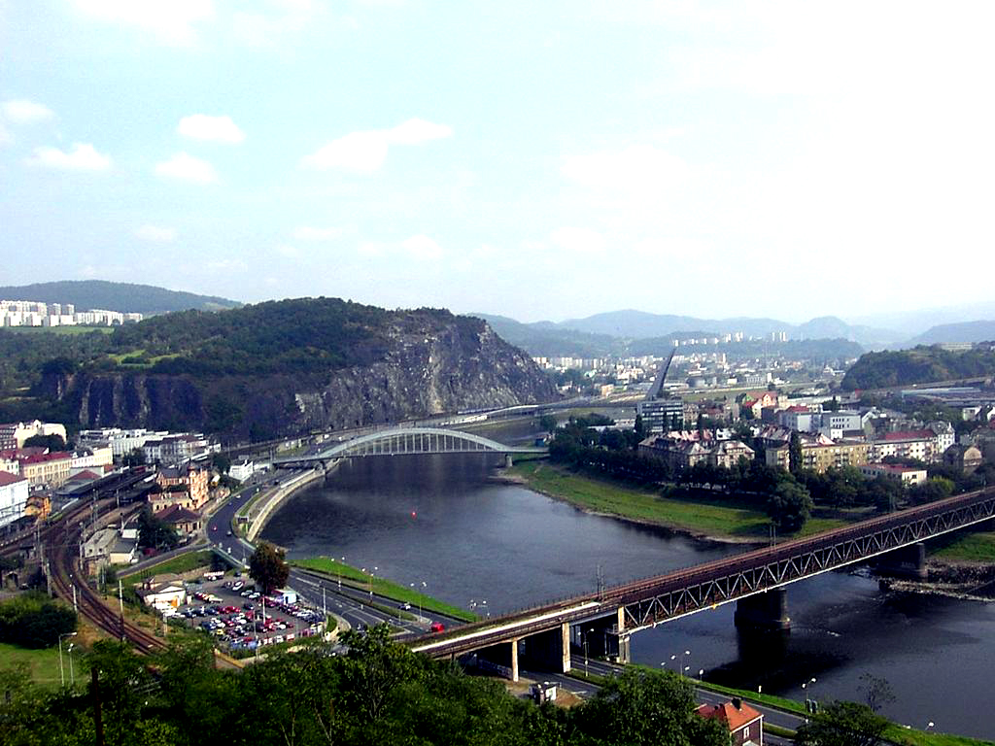
Ústí nad Labem
Has got :
100 000 of people living in.
Is the 7th biggest town in the Czech republic.
The city has three professional theater companies
Ústí nad Labem plays first Hockey League of the Czech Republic club HC Slovan Ústečtí lvi.
Among the most significant monuments include the neo-Gothic rebuilt Church of the Assumption of the Virgin Mary with the leaning tower ,and the castle ruins of the castle Střekov of put restaurent Větruše .

Slide 2
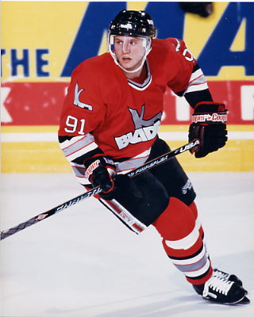
,
FAMOUS PEAOPLE FROM ÚSTÍ
Jan Čaloun was profesional hockey player who won the olimpics and the World Champion ship
Zuzana Bergrová famous czech athlet she was third at the European Champion ship

Slide 3
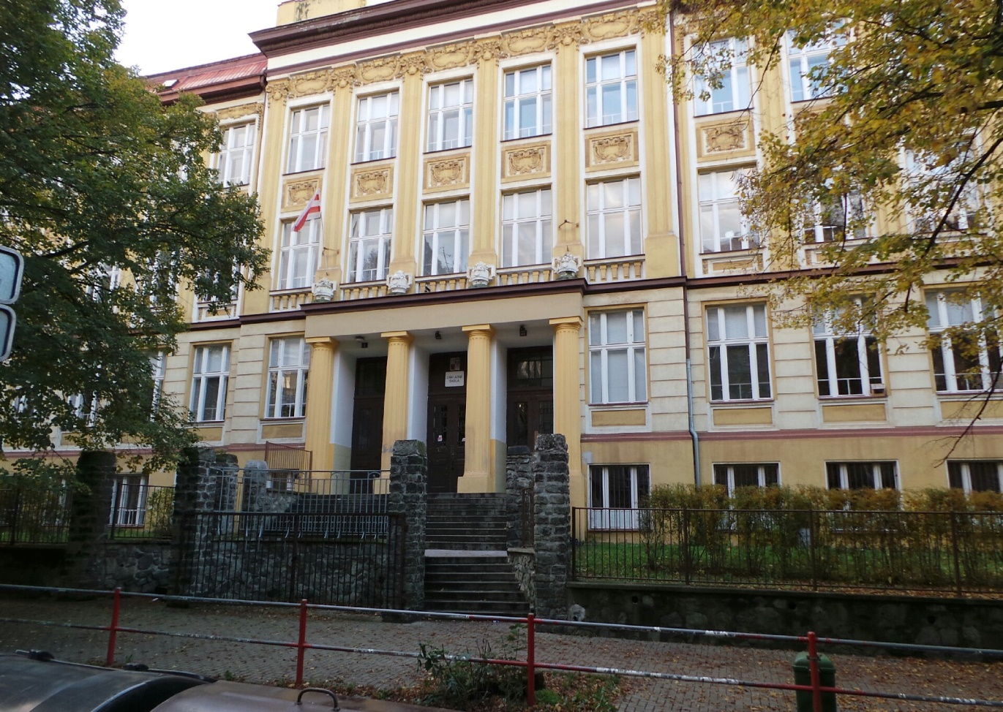
THE SCHOOL

Slide 4
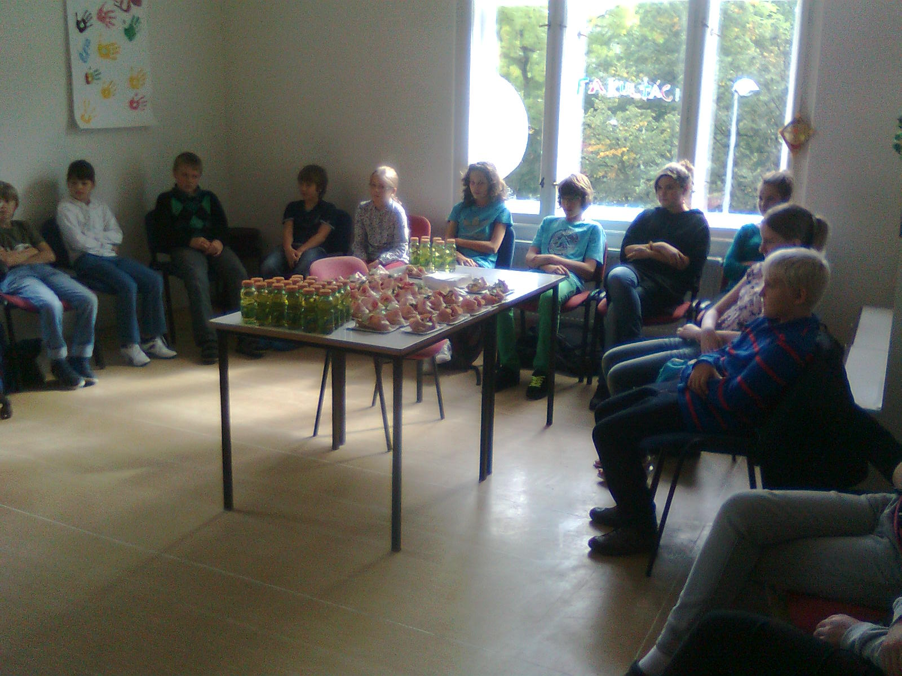
FAKULŤÁCI

Slide 5
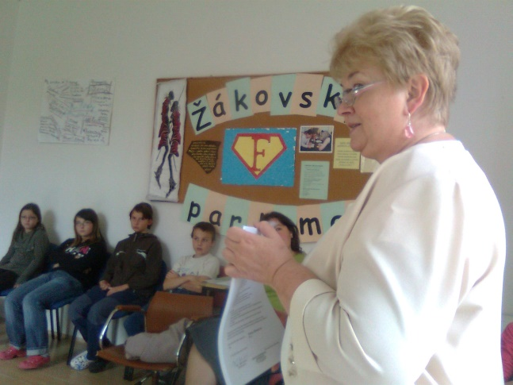
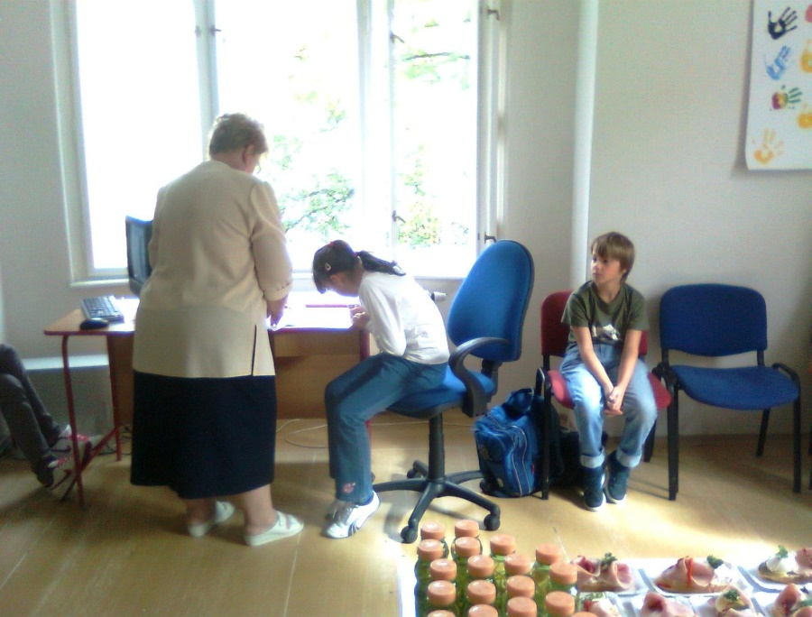
the INAUGURATION
Every parliament member have to sight agreement

Slide 6
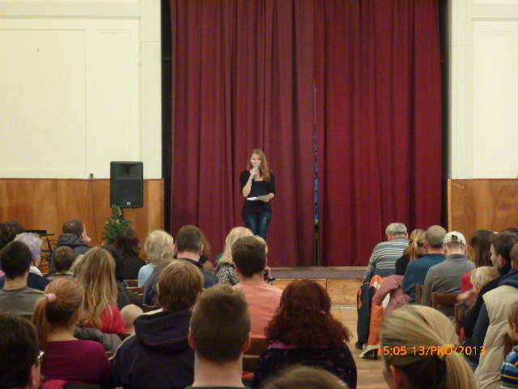
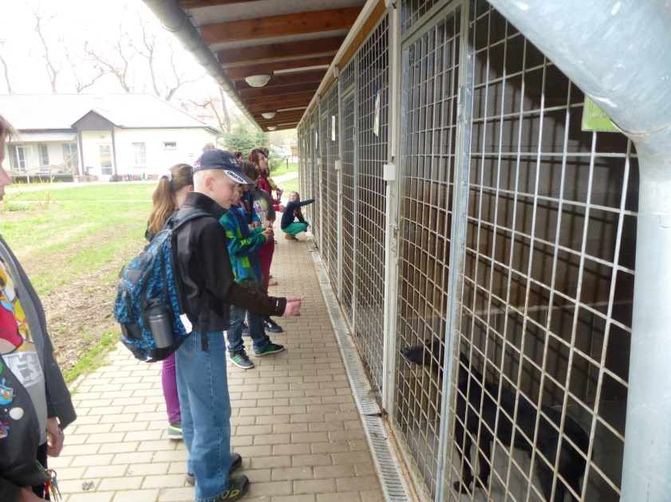
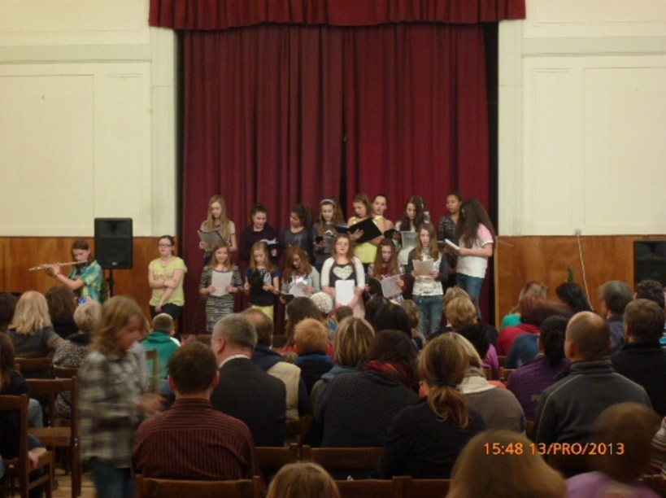
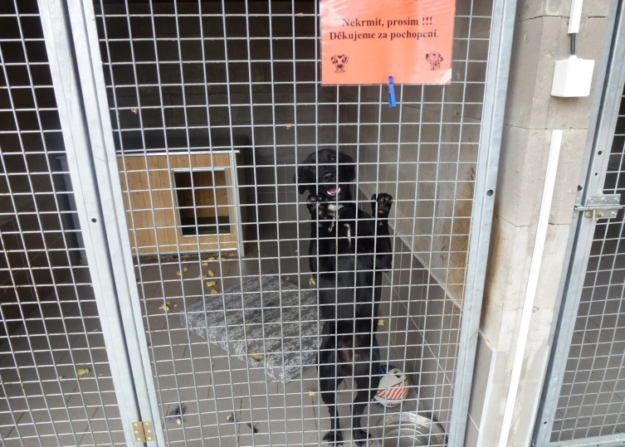
CHARITI
We did a lot of good deeds:
we fed abando
fed animals

Slide 7
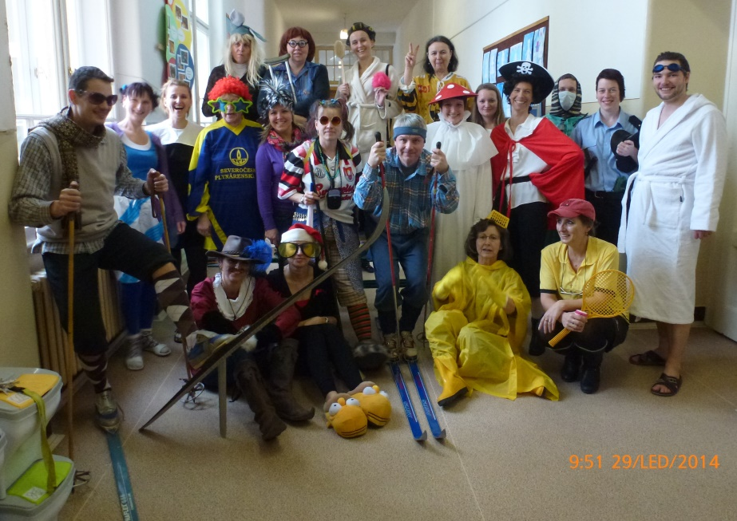
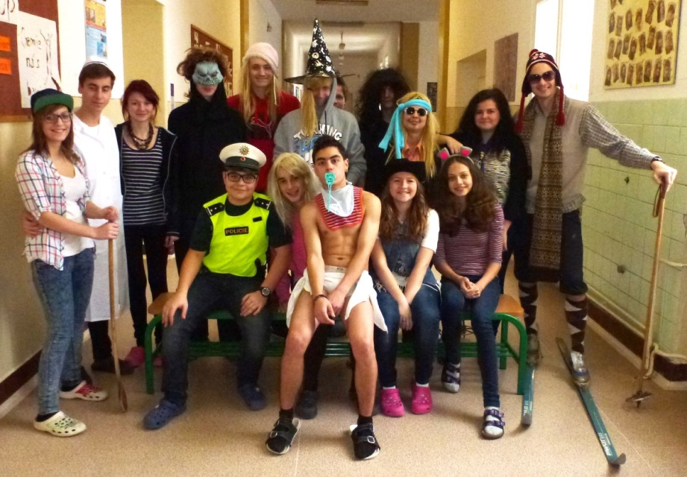
DAY OF CRAZY VINTAGES
Day of crazy disguise is one of new projects
Had a great success , especially in older vingates.

Slide 8
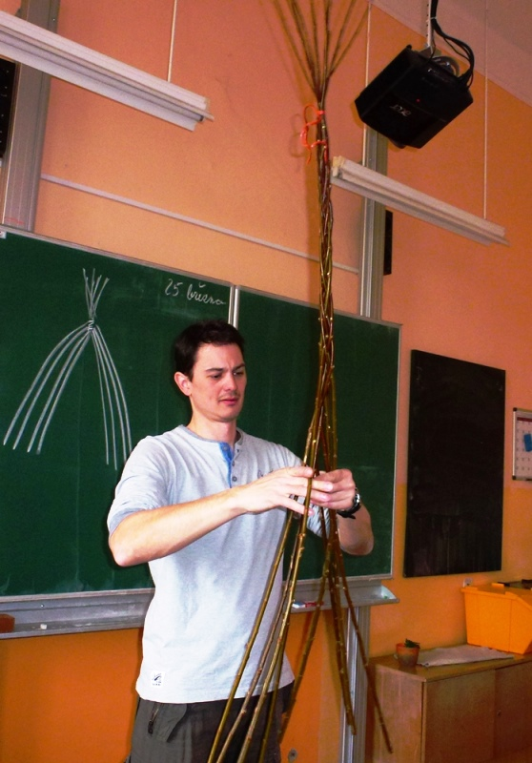
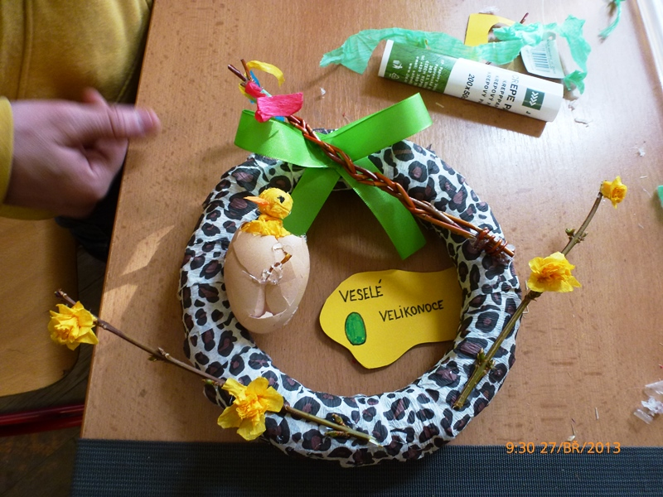
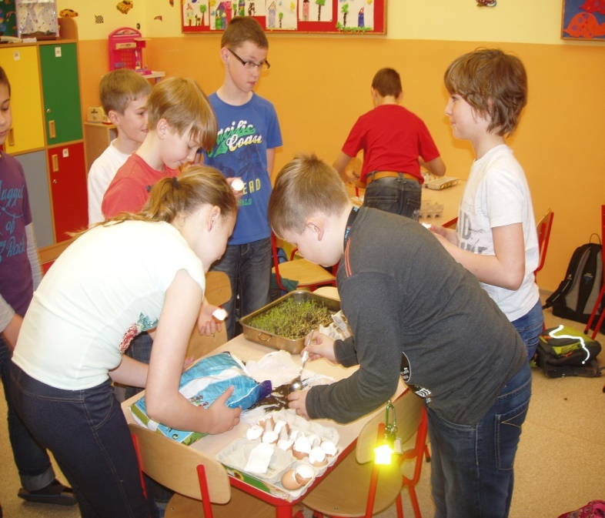
Every year are teachers learning about tipical czech tradition´s
Easter workshops
Our best project

