Slide 1
Big issues in small hands
Erasmus plus 2014-16
1st Vrontados Primary School
Chios, Greece

Slide 2
Greece is located in the Mediterranean Sea

Slide 3
The capital of Greece is Athens
The place where democracy was born

Slide 4
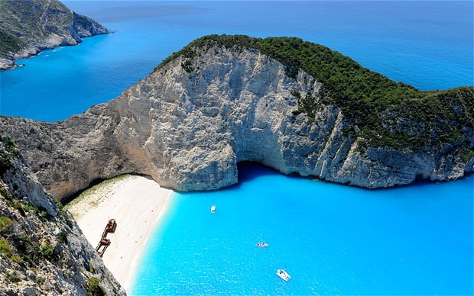
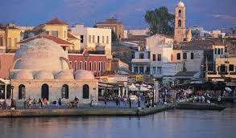
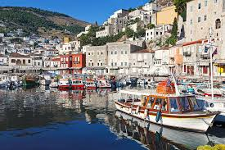
Greece has lots of beautiful islands

Slide 5
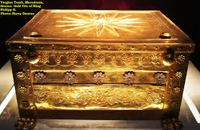
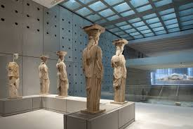
Greece is a country of great interests and diverse cultures

Slide 6
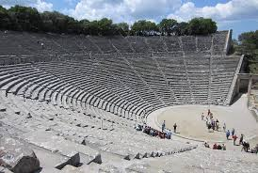
The place where drama was written and it is still performed

Slide 7
Chios
Chios is situated in the eastern part of Greece. It is the 5th biggest island and has a population of 55.000 people.

Slide 8
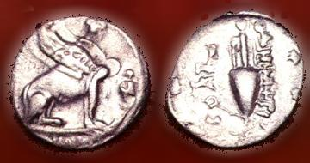
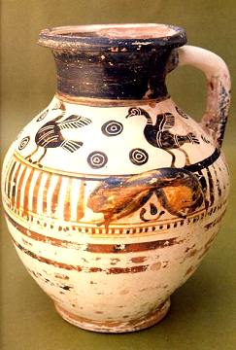
Places of interest in Chios

Slide 9
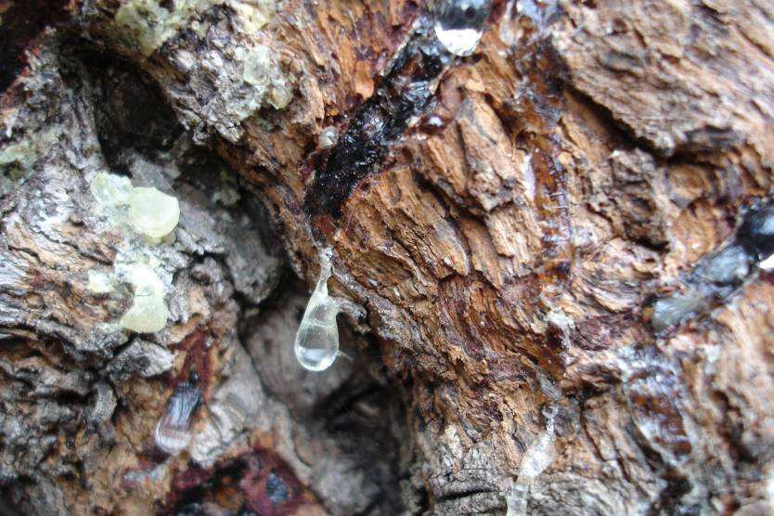
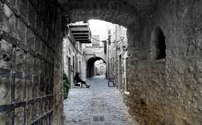
What Chios is famous for
tulips
Isolated beaches
Pistacia-lent
Medieval - villages

Slide 10
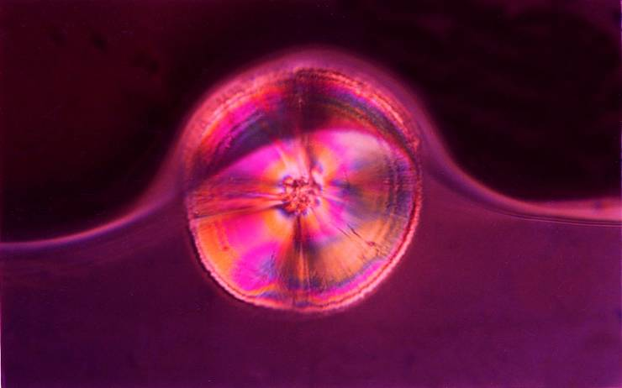
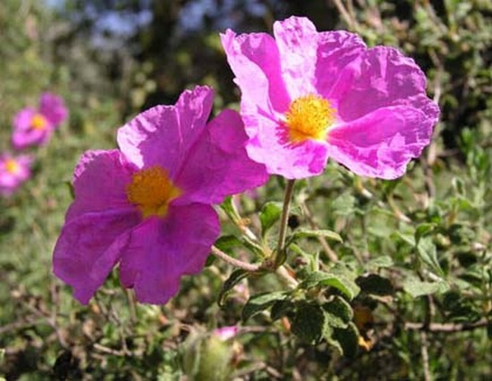
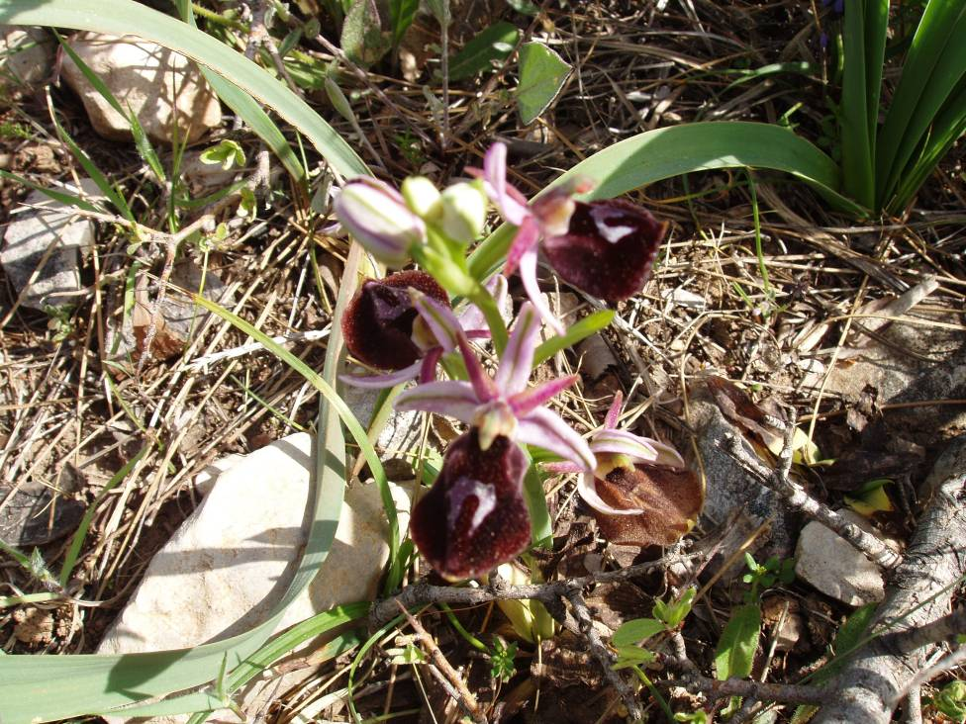
Chios nature
Pistacia-lent
Cistus
ophrys

Slide 11
Our school is situated in Vrontados,
a small town 5km away from the capital.

Slide 12
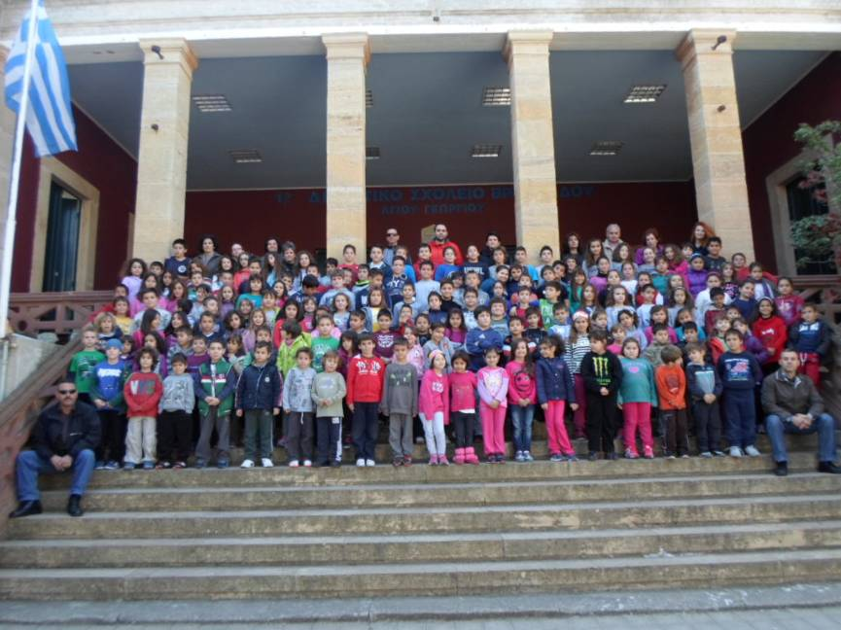
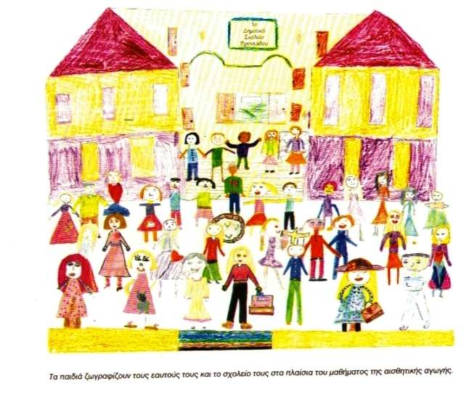
1st Vrontados Primary School
Our school was built in 1915.
In our school there are 142 pupils aged seven to twelve and eighteen teachers.

Slide 13
Our school

Slide 14
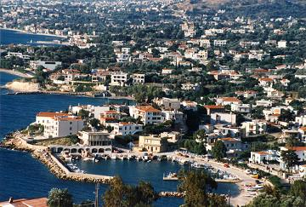
Our neighbourhood

Slide 16
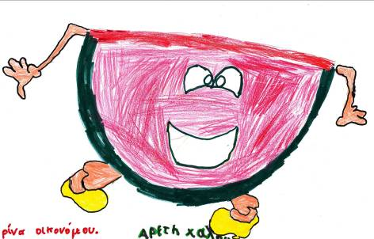
We are looking forward to a successful Erasmus plus programme with our partners:
Czech, Poland, Estonia,France and Turkey.

